Slide 2
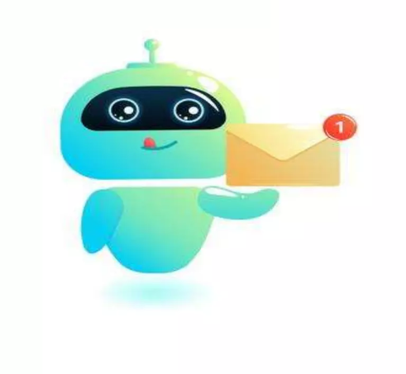
LANGUAGES USED:
HTML
CSS
C LANGUAGE

Slide 3
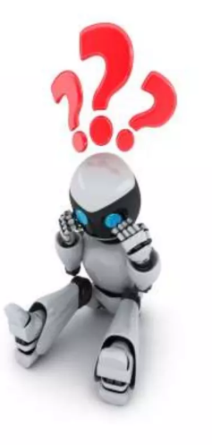
What is a chatbot?
A chatbot is a service powered by rules and sometimes artificial intelligence,that you interact with via chat interface.
This service could be any number of things,ranging from buisness to fun.

Slide 4
How chatbots work?
Two types of chatbots:
i. One function based on a set of rules:
This bot is very limited.
It can respond to only specific commands.
If you say the wrong thing it doesn’t know what you mean.
ii. The other more advanced version uses machine learning:
This bot has an artificial brain.
You don’t have to be specific when you are talking to it.

Slide 5
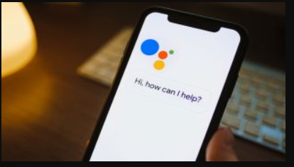

Some popular chatbots:
Google Assistant
Alexa
Cortana
Siri etc…

Slide 6
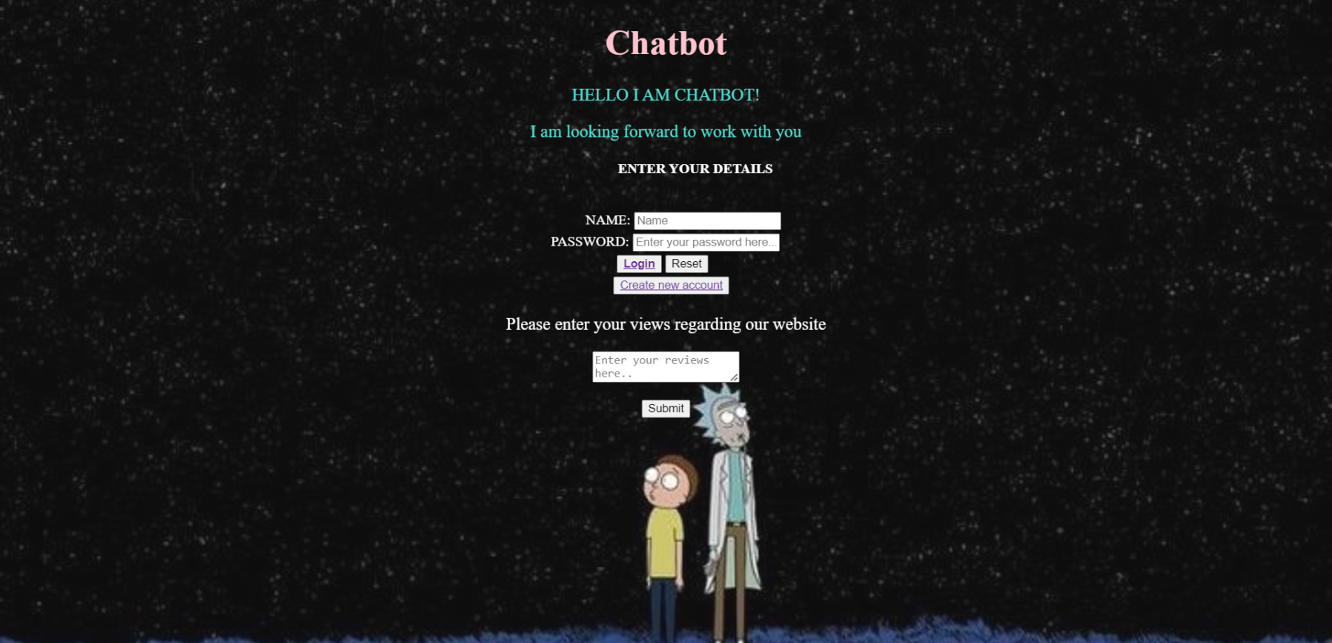
Front page

Slide 7
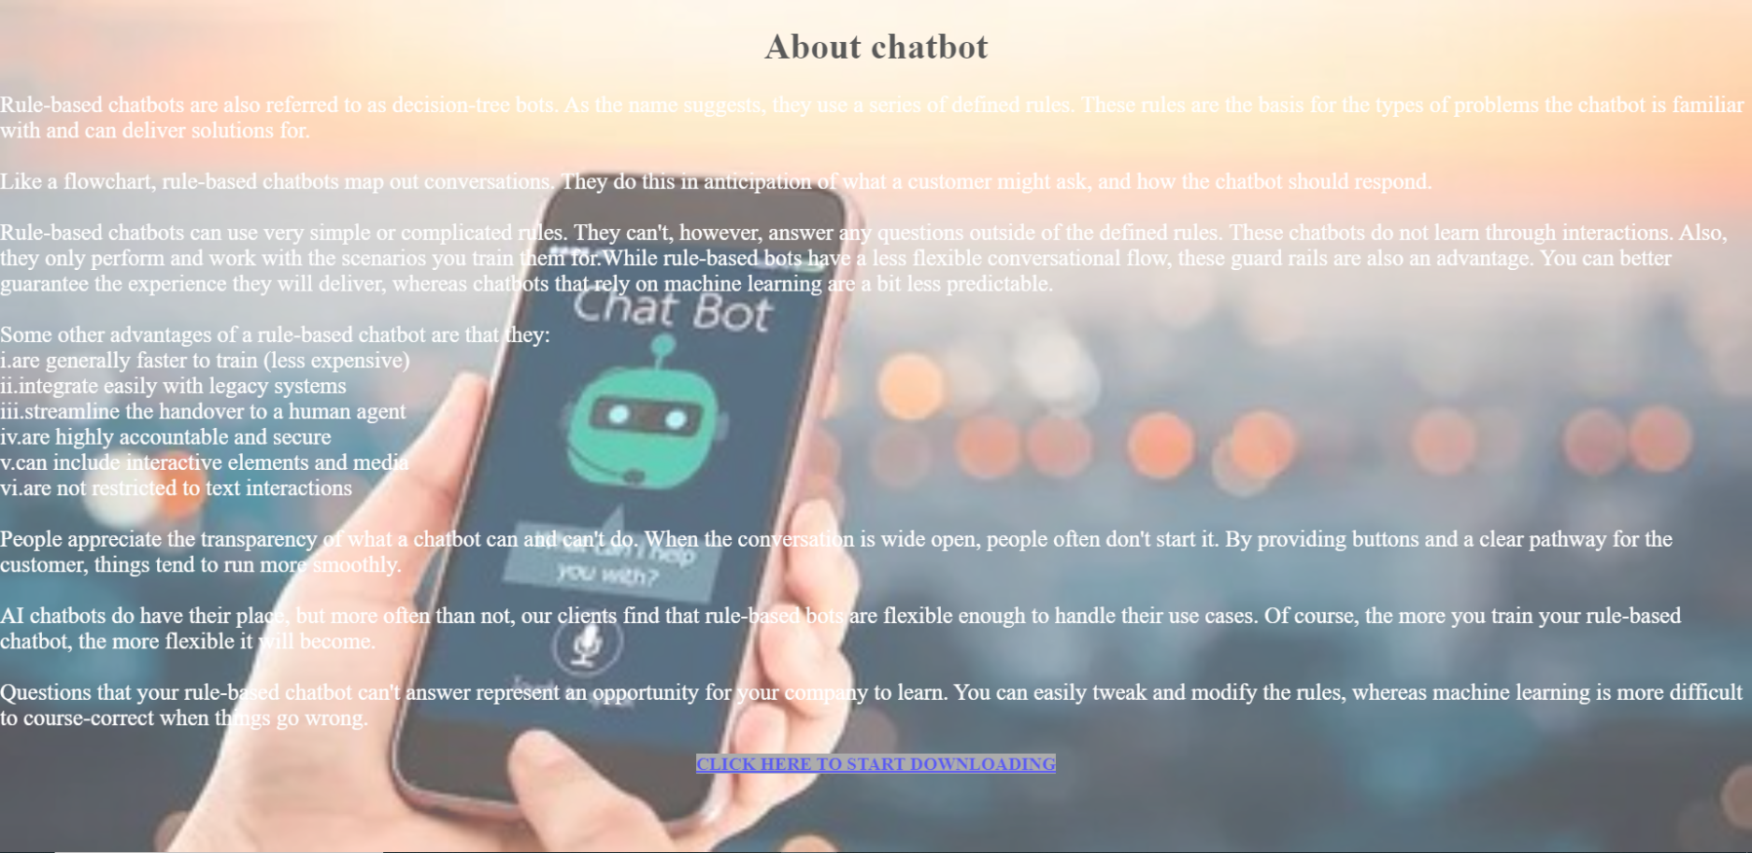
AFTER LOGIN

Slide 8
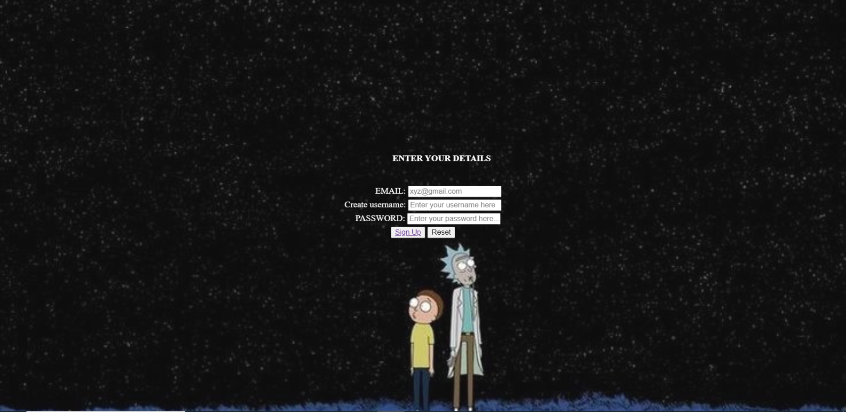
SIGN UP

Slide 9
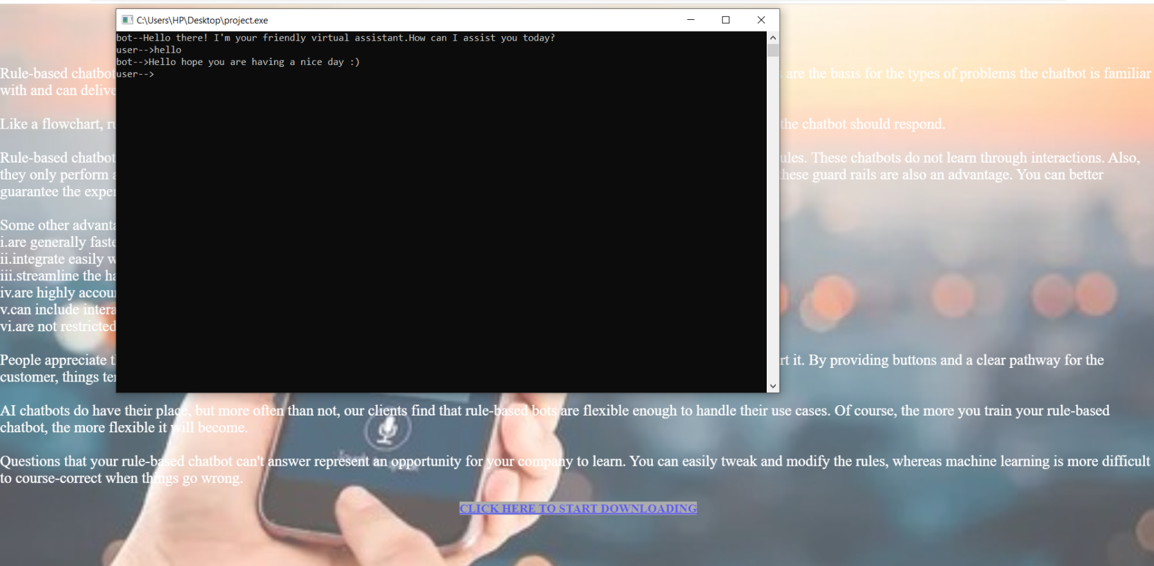
AFTER DOWNLOAD

